Slide 1

Welcome to
Church Lane
Pre School

Slide 3
Welcome
Church Lane Nursery is a specially designed Early Years unit which is based on the site of Church Lane Primary School.
At Church Lane Nursery we embrace the principles of the Early Years Foundation Stage and feel passionate about supporting children’s individual needs as they learn and grow with us. Learning opportunities are carefully planned around your children’s interests and needs, and a carefully tailored EYFS curriculum is in place to support your child becoming school ready.
From your very first visit to Church Lane you and your child become our priority. To be able to provide the best early years experiences for your child we encourage you to take the time you need to ask questions, view our site and spend time in the room with your child, which is why we offer free customized taster sessions.
Being three is so grown up and we do not underestimate the pressures these young beings may feel as they are prepared for school life. It is our mission, passion and belief that this special year should be celebrating the skills children have learned already and teaching them to use them in new ways. We can now hold paint brushes, play with shakers, build towers, make roads, dig tunnels, but now we begin to think about what, why, when and how. The children are challenged to think critically about their own play and discoveries and given the support to make decisions, and make things happen in their own way.

Slide 4
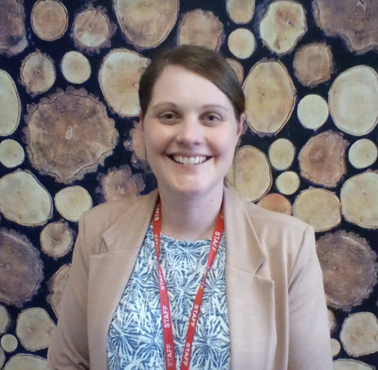
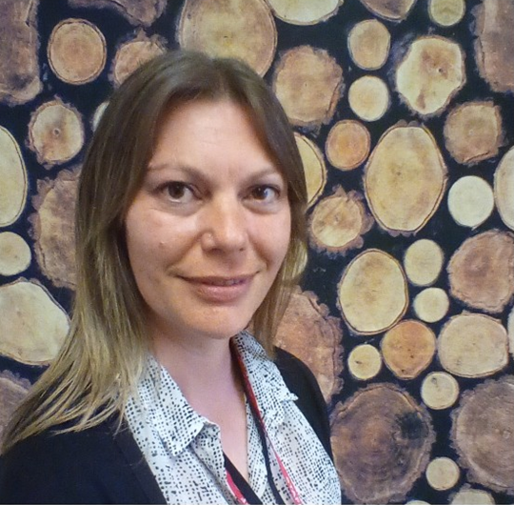
Meet the Team
Tash
Nursery Deputy Manager
I have worked at Church Lane Nursery since 2017, although I have worked with children for 9 years. and am Level 3 qualified in Children and Young people’s workforce. In my spare time I enjoy spending time with my family and going on long walks.
The early years is by far my favourite age group. I enjoy seeing the awe and wonder in the children’s faces as they learn something new, test their abilities and further their education. I find no greater pleasure then preparing these little people for the big world which is school.
Kelly
Reception Teacher and EYFS Lead
I have worked at Church Lane for 12 years and I am a qualified teacher and specialise in Early Years. Alongside teaching I also work with the Department for Education and our local teaching hub to strengthen early years practice across Lincolnshire. In my spare time I enjoy spending time with my two boys and visiting new places.
There is no other place I would rather work than in the Early Years sector. I love how the children make me laugh and no day is the same!

Slide 5
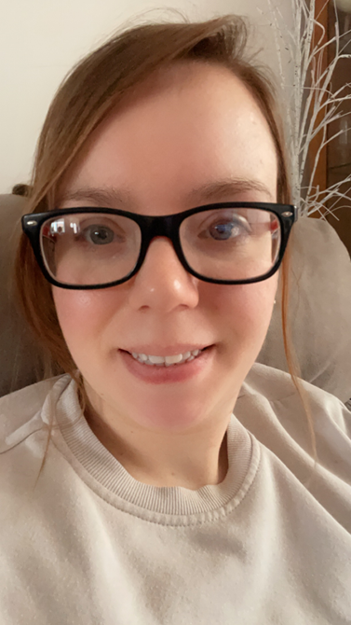
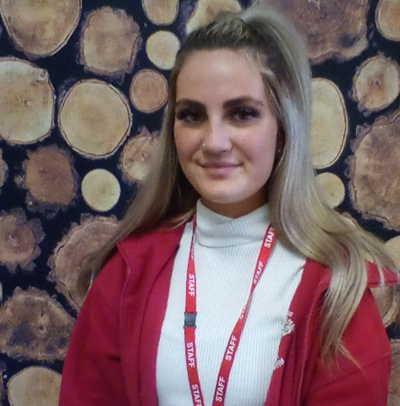
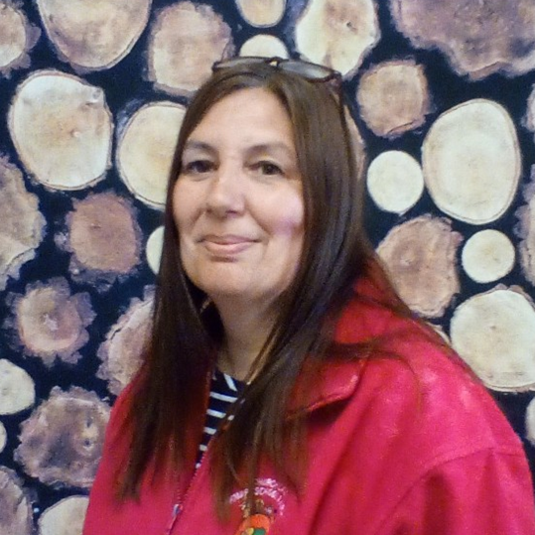
Elise
I am a Level 2 apprentice that started in Nursery in February 2023
In my spare time I love taking my dog for a walk and spending time with my friends and family.
I really enjoy working with the children and seeing their learning progress.
Ellie
Nursery Practitioner
I have worked at Church Lane for 10 years and am Level 3 qualified in Children and Young people’s workforce. In my spare time I really enjoy visiting and spending time with my family and crafting things.
I love working in early years as there is no better feeling then putting smiles on the children’s faces and seeing them learn, grow and develop before starting their journey to school.
Jo
Nursery Practitioner
I have worked at Church Lane since August 2014 and am Level 3 qualified in Child’s care, Learning and Development. In my spare time I like walking my dog and spending time with my family.
I enjoy working in Early Years and helping the children grow in their abilities to start their journey into school life.

Slide 6
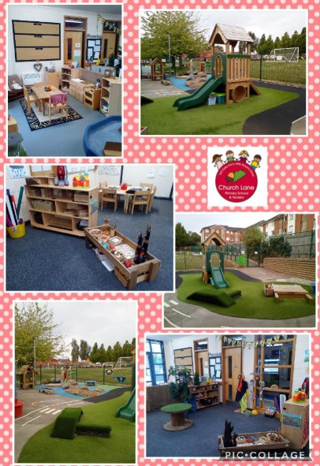
Our Setting

Slide 7
Opening Times
We are open Monday to Friday, 8am until 5.45pm term time only
Meals
Lunch time meals are provided by a local catering company. Meals are freshly made and delivered each day.
All snacks and evening meals are prepared on site. Fruit and milk is provided free of charge for morning snack.
You may provide a healthy packed lunch if you prefer.
Early Years Entitlement
Church Lane Nursery supports the delivery of free early years education for 3 year olds. Every 3 year old is eligible for 15 hours per week (term time only) beginning the term after their 3rd birthday (e.g date of birth 13/5/11 entitlement begins 1/9/14).
The extended 15 hours funding is based on eligibility criteria. For further information please visit
www.gov.uk/help-with-childcare-costs/free-childcare-and-education-for-2-to-4-year-olds

Slide 8

The Early Years Foundation Stage (EYFS) is the curriculum guidance followed to ensure the children are supported in all areas of their learning and development. This ensures that our highly skilled practitioners are supporting children as they progress through the different stages of early learning, from being able to grasp a toy out of a basket to making intricate marks as they prepare for school life. We celebrate and share this journey with you through a learning journal.
The characteristics of effective teaching and learning In planning and guiding what children learn, practitioners must reflect on the different rates at which children are developing and adjust their practice appropriately. Three characteristics of effective teaching and learning are:
• playing and exploring – children investigate and experience things, and ‘have a go’
• active learning – children concentrate and keep on trying if they encounter difficulties, and enjoy achievements
• creating and thinking critically – children have and develop their own ideas, make links between ideas, and develop strategies for doing things Statutory framework for the EYFS Development Matters Non-statutory curriculum guidance for the early years foundation stage
To embrace the early learning of all children, activities are planned around their interests and needs as well as in line with our tailored curriculum. The EYFS guides us as we ensure children are achieving to their full potential, practitioners apply this knowledge to the marvellous mud pies and natural collages the children make in the garden, and to the marks they make in the cornflour as they begin to make letters to represent their name. Children flourish when given the opportunity to ‘do’, to create, to imagine and to play.. We believe in following their lead…

Slide 9

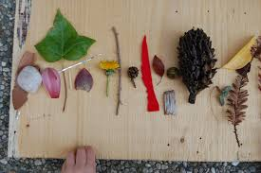
Natural Explorers
Children are natural explorers and many prefer to explore the outdoor learning environment. To ensure children are able to explore fully it is important that they wear appropriate footwear and have a suitable coat. Storage is also provided for children to leave their own wellington boots at nursery.
Outdoor learning is an important part of every child’s day. Free flow access is provided to the outdoor area during both the morning and afternoon sessions.
Children will have opportunities to explore construction, water, gardening, sand, and much more on a large scale in our own secure garden area. Children develop independence in self care routines as they are supported and encouraged to put on their wellington boots and coats to play outside.
Please ensure your child has a pair of wellington boots and a suitable outdoor coat. Please clearly label your child’s belongings.

Slide 10

Fees and Sessions
Our session are as follows:
AM session 8.30-11.30
PM session 12.15-3.15
Full day session 9-3
Extended full day session 8-6
All non funded hours are charged at £4.20 per hour.
Hot lunches can be provided at a charge of £1.50 per day
Home made teas are provided at a cost of £1.50 per day
Fees are charged monthly in arrears. No deposit required.
Fees still apply if children are absent.

Slide 11




Contact Us
School Office 01529 302696
Church Lane Nursery
Church Lane
Sleaford
Lincs
NG34 7DF
Email enquiries@sleafordchurchlane.lincs.sch.uk
Website www.churchlaneprimary.org.uk
‘Like’ us on Facebook www.facebook.com/John.Smith

Slide 12
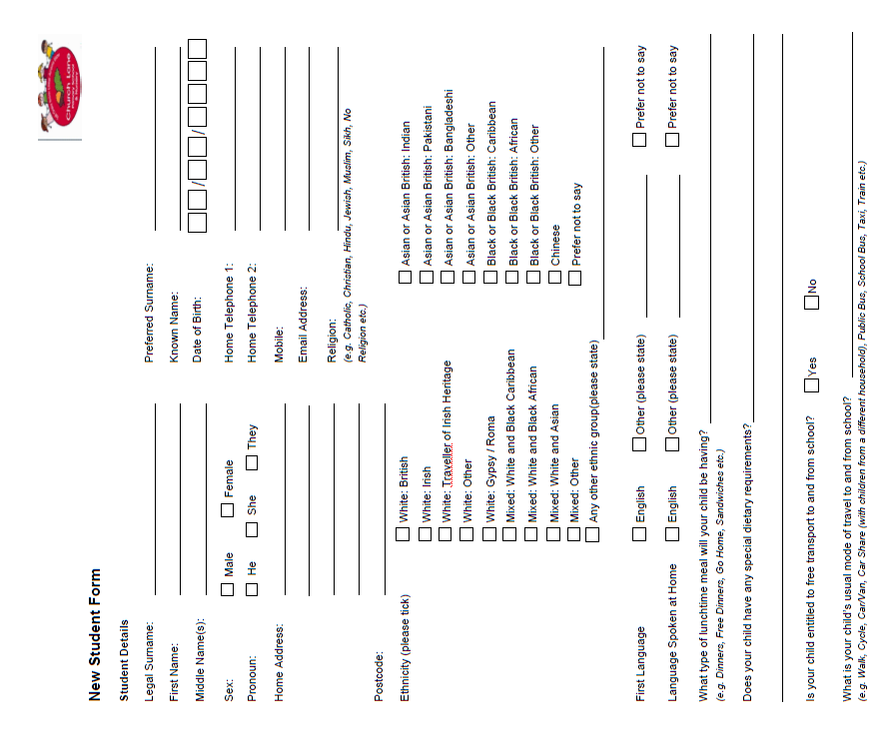

Slide 13
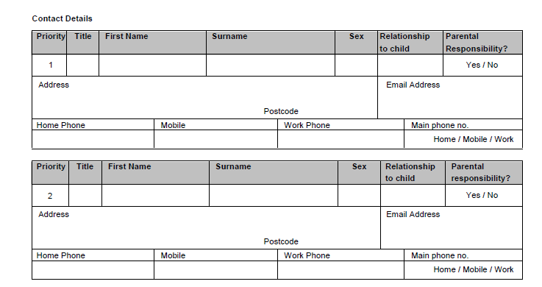
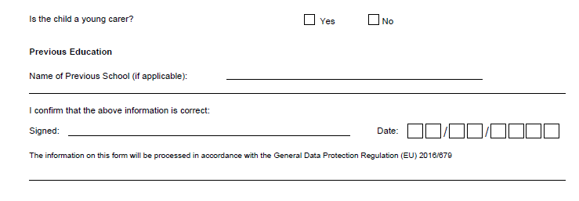
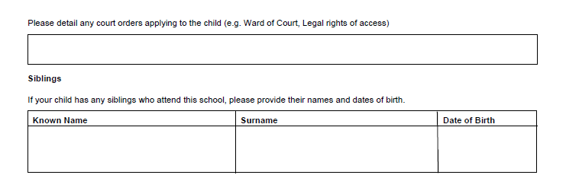

Slide 14
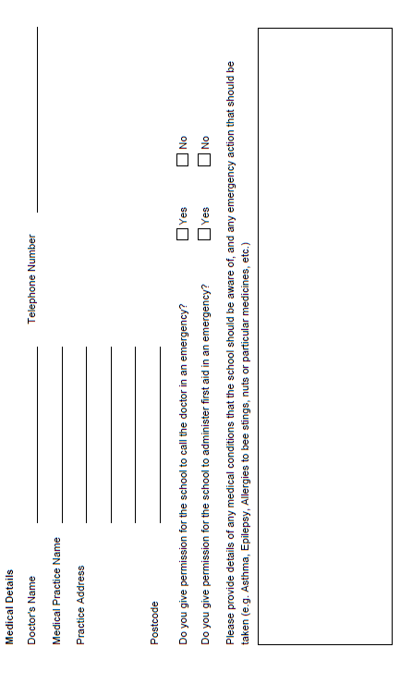



Slide 15
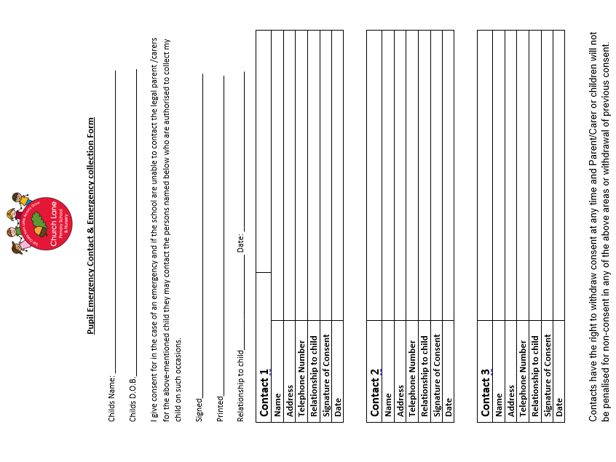

Slide 16
All About Me
Name__________
Date______
Date of Birth_________
Songs and Stories I enjoy
Festivals I celebrate
Things I enjoy
How I like to be settled when I am upset
People and pets special to me
My favourite toys and things that are special to me (comforters)
Photo here please
Things I can do by myself
Things I am learning to do
Where I am from and languages I speak
Church Lane Nursery
Working with families to give children the best start in education

Slide 26
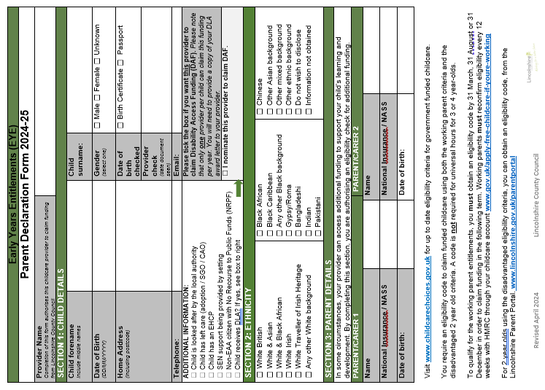

Slide 27
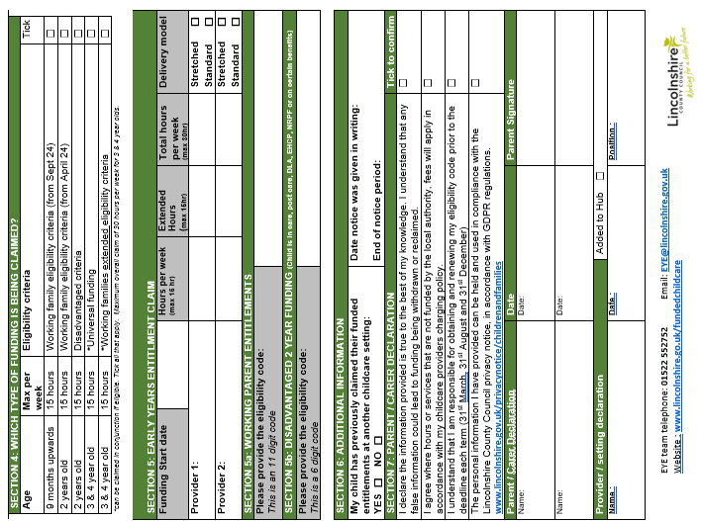

Slide 28


Slide 29


