Slide 1
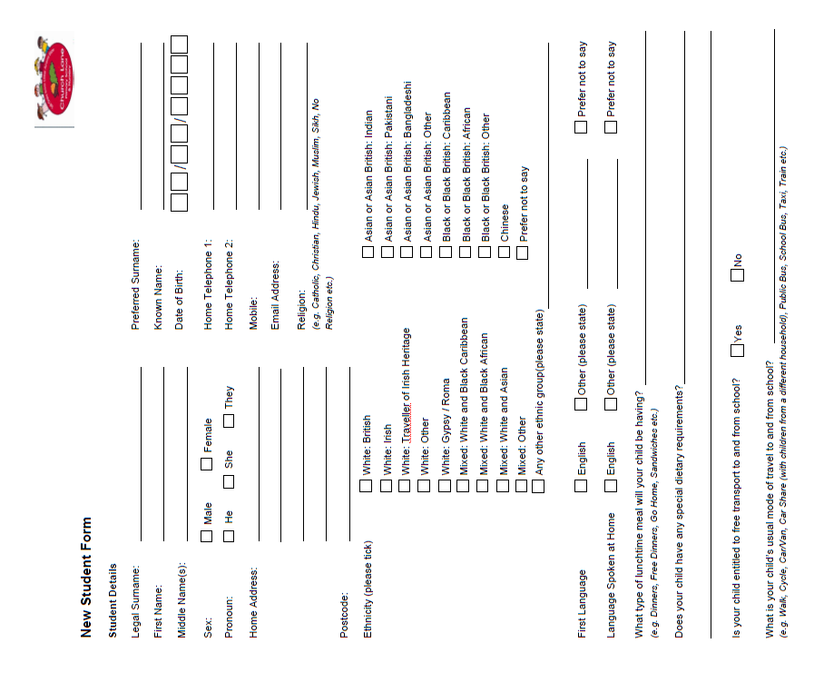

Slide 2
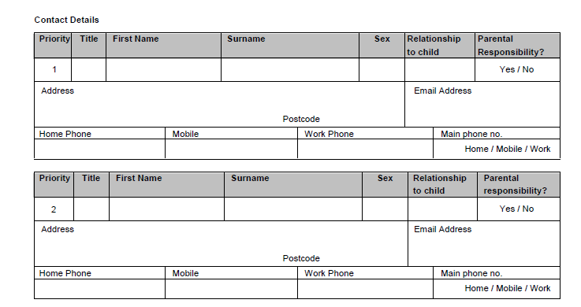
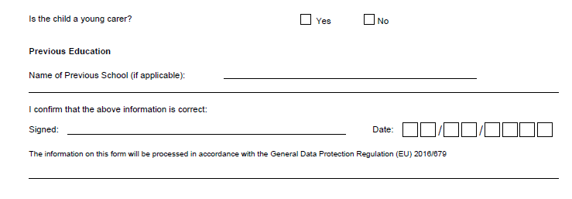
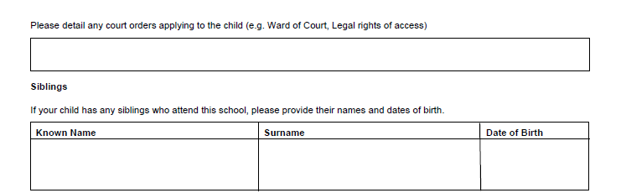

Slide 3
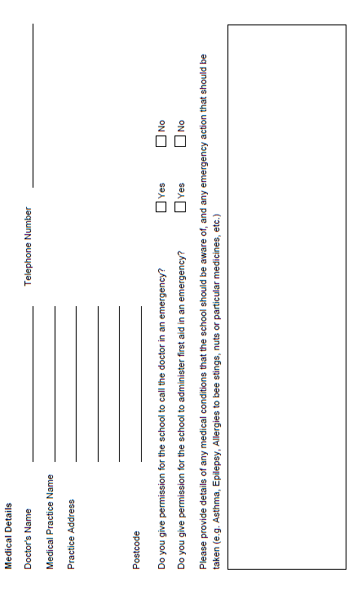
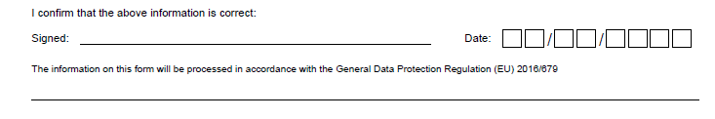
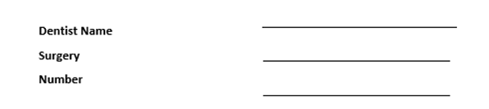

Slide 4
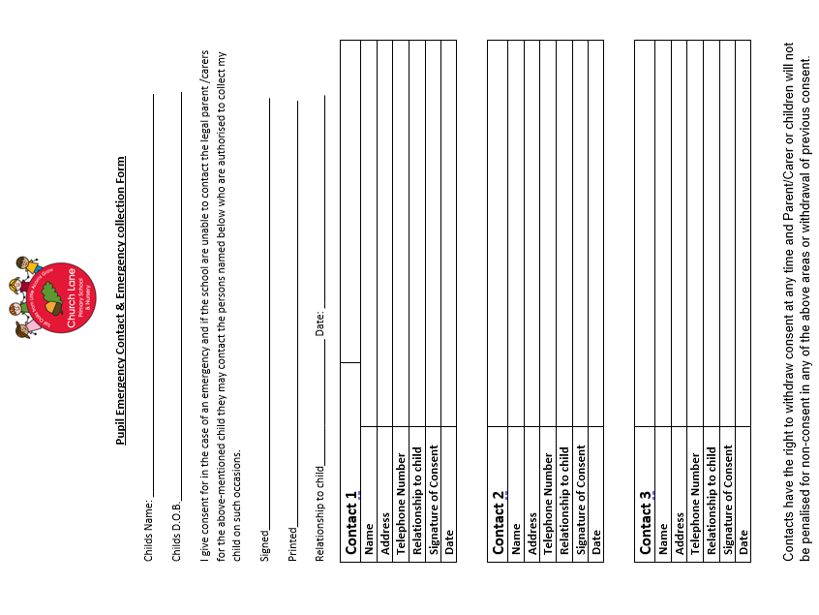

Slide 5
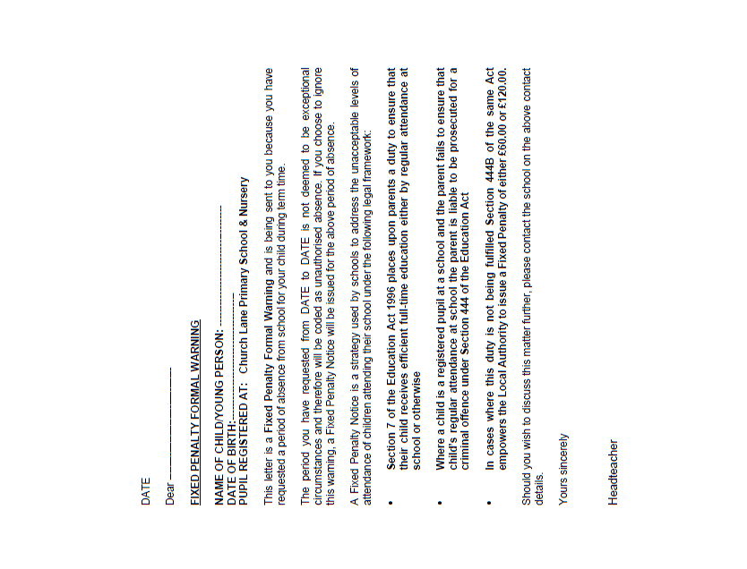
Example letter

Slide 6
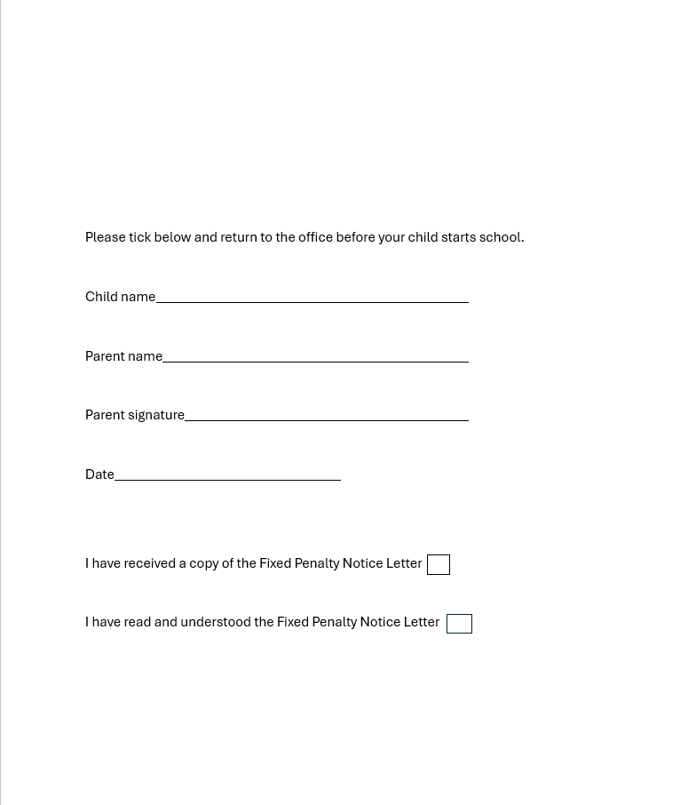

Slide 7
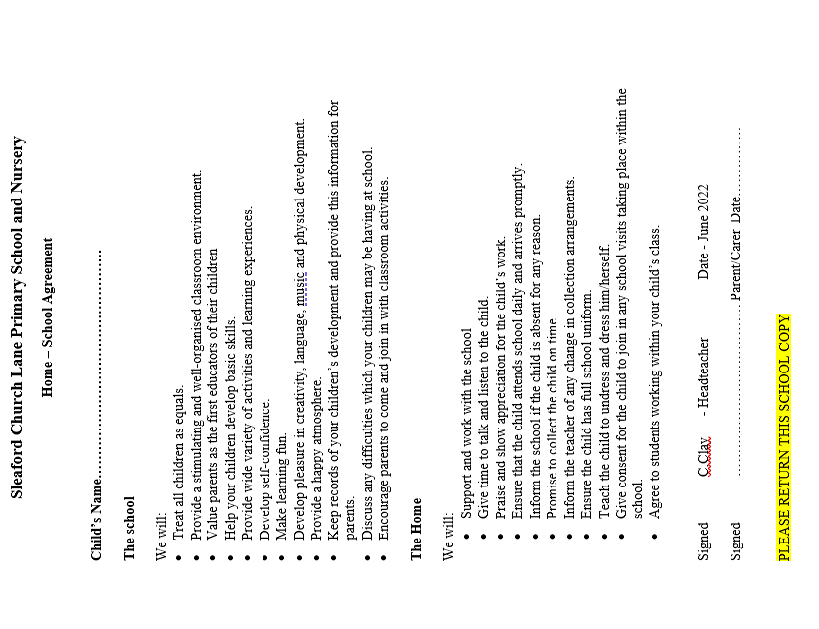

Slide 8


Slide 9
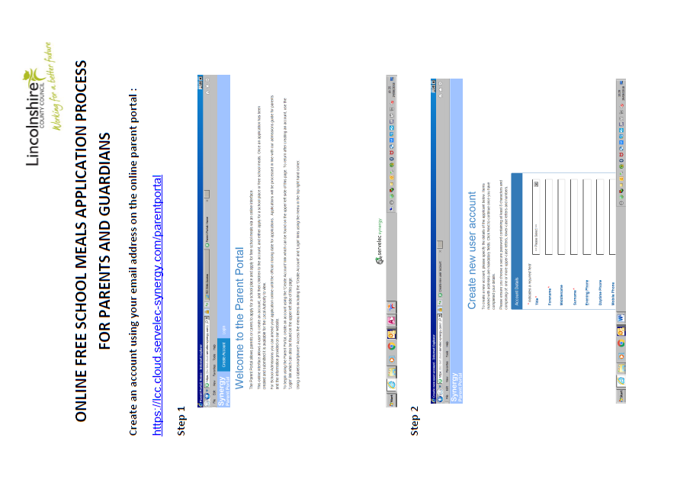

Slide 10
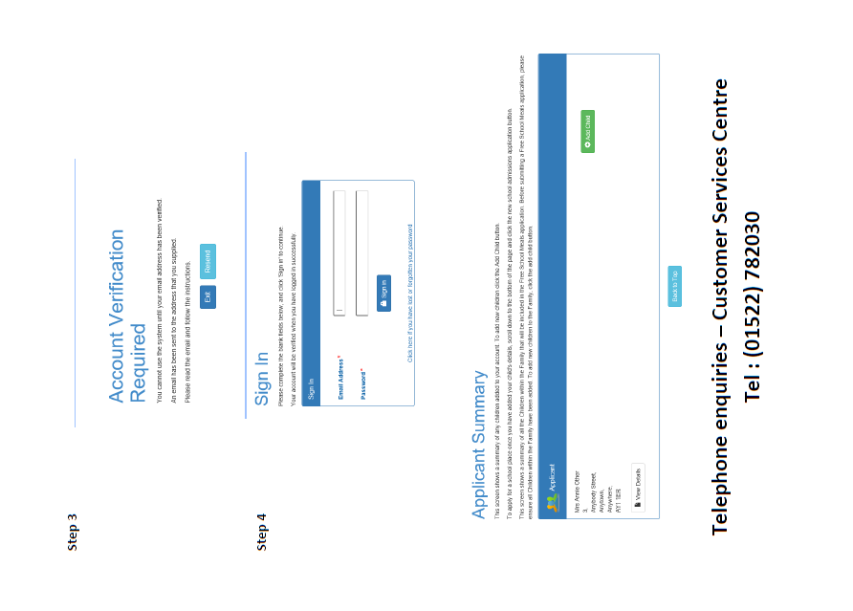

Slide 11


Slide 12
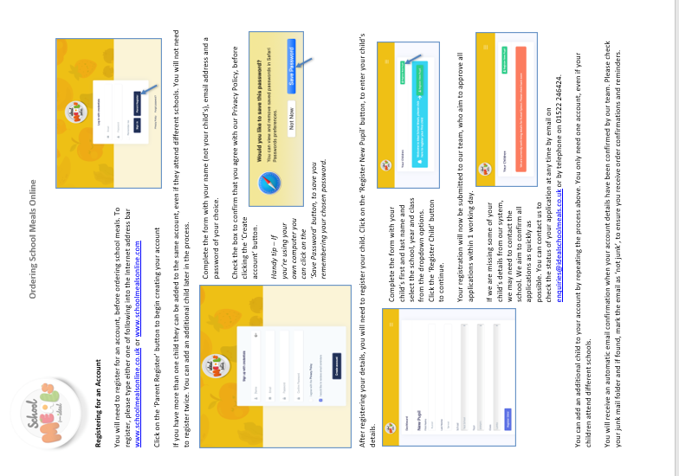

Slide 13
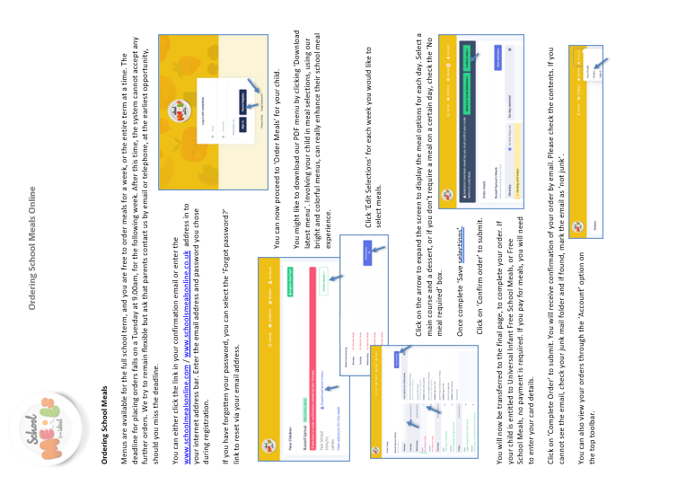

Slide 14
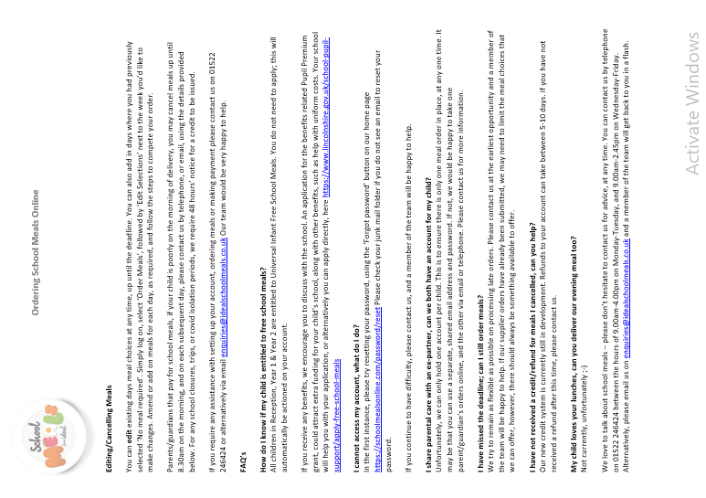

Slide 15

As part of our vision to ensure we provide the best possible education to all of our children, we are proud to announce the launch of the Church Lane Primary School Academy of Arts from September 2022.
As we know, some children are more creative than academic and struggle with core subjects in school. This can contribute to low self esteem, behavioural issues, low confidence and struggles creating friendships.
The Church Lane academy of Arts will run from 3pm -5pm once a week initially and will give our pupils the opportunty to access professional lessons in the Arts and work towards accredited exams.
The cost of lessons, uniform and exams will be covered by the school so there will be no cost to families.
We hope that the introduction of this will support children, who are less confident within class; who struggle to concentrate or those that take part in low level disruptive behaviour, to learn different skills and ways of expressing themselves and allow them to feel a sense of achievement and belonging. By tackling these areas, a child's outlook and the way they approach subjects should be more positive and confident.
If you would like to sign your child up to our academy of arts dance lessons, please email enquiries@sleafordchurchlane.lincs.sch.uk

Slide 16
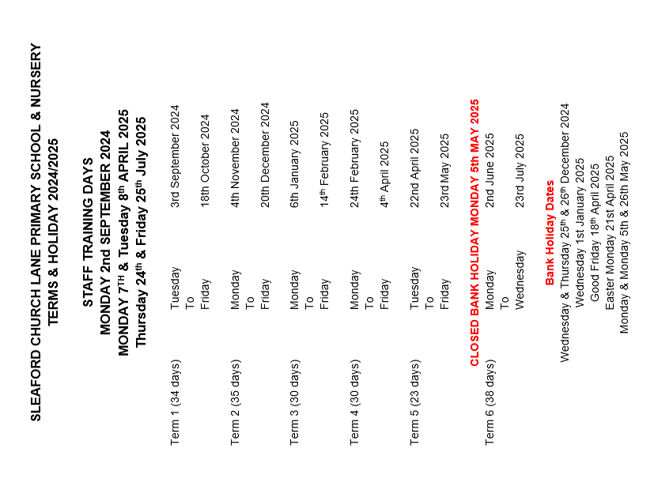

Slide 17
